Slide 1


Vishwanathan.R
18-Dec-2022

Slide 2

Outline
Executive Summary
Introduction
Methodology
Results
Conclusion
Appendix

Slide 3
Executive Summary
The main objective of the project is to predict whether the first stage of SpaceX Falcon9 rocket lands successfully in order to reduce price of each launch
Data was collected from public SpaceX API and SpaceX Wikipedia pages.
Explored data using SQL, data visualization tools like matplotlib and plotly, folium maps, and dashboards.
Feature engineering and feature selection helped in determining optimal columns to be used as features.
Explored multiple machine learning models and used GridSearchCV to find best hyper-parameters for machine learning models
All models produced similar test accuracy of about 83.33%. More data is required for better model determination and accuracy.

Slide 4
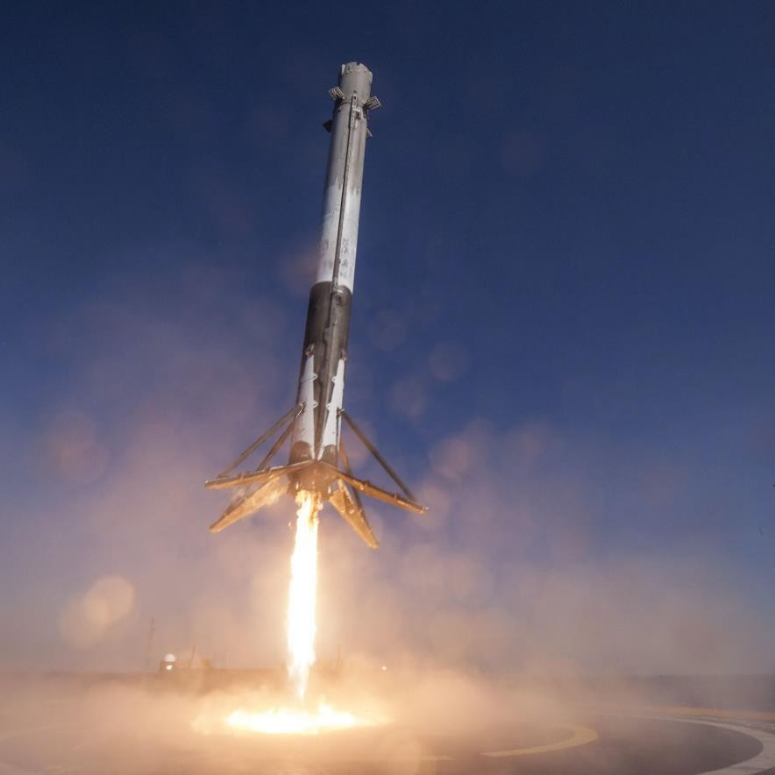
Introduction
Background:
Commercial Space Age is Here
Space X has best pricing ($62 million vs. $165 million USD)
This is largely due to ability to recover part of rocket (Stage 1)
Objective:
The objective is to evaluate the viability of the new company Space Y to compete with Space X.
Desirables:
The best way to estimate the total cost for launches, by predicting successful landings of the first stage of rockets
Where is the best place to make the launches

Slide 5

Section 1

Slide 6
Methodology
Executive Summary
Data collection methodology:
Data from Space X was obtained from 2 sources:
Space X API (https://api.spacexdata.com/v4/rockets/)
Web Scraping (https://en.wikipedia.org/wiki/List_of_Falcon/_9/_and_Falcon_Heavy_launches
Collected data was enriched by creating a landing outcome label based on outcome data after summarizing and analysing the features

Slide 7
Methodology
Executive Summary
Performed exploratory data analysis (EDA) using visualization and SQL
Performed interactive visual analytics using Folium and Plotly Dash
Performed predictive analysis using classification models
Data collected until this step were normalized, divided into training and test data sets and evaluated by four different classification models and the accuracy of each model was evaluated using different metrics

Slide 8
Data Collection
The Data collection process involved a combination of API requests from Space X public API and web scraping data from a table in Space X’s Wikipedia entry.
Space X API Data Columns:
FlightNumber, Date, BoosterVersion, PayloadMass, Orbit, LaunchSite, Outcome, Flights, GridFins, Reused, Legs, LandingPad, Block, ReusedCount, Serial, Longitude, Latitude
Wikipedia Webscrape Data Columns:
Flight No., Launch site, Payload, PayloadMass, Orbit, Customer, Launch outcome, Version Booster, Booster landing, Date, Time

Slide 9
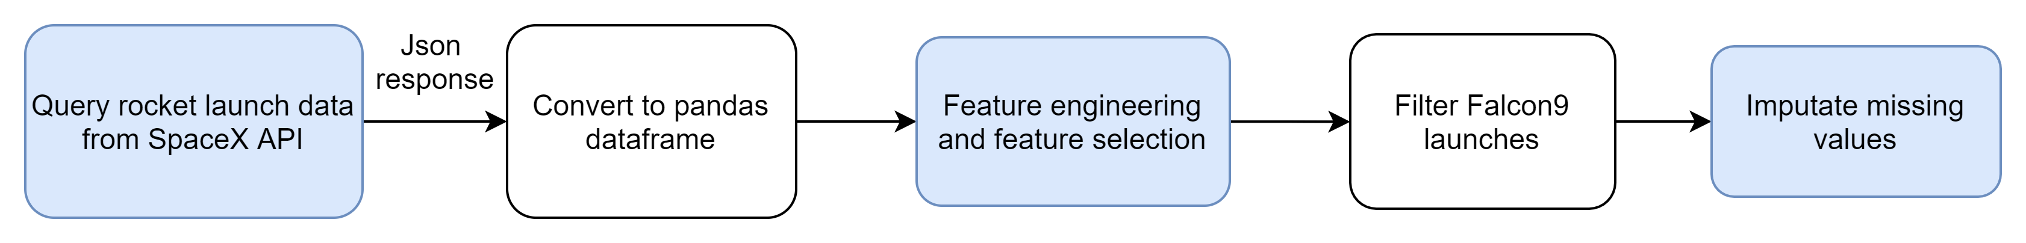
Data Collection – SpaceX API
GitHub Url: Data Collection - API

Slide 10
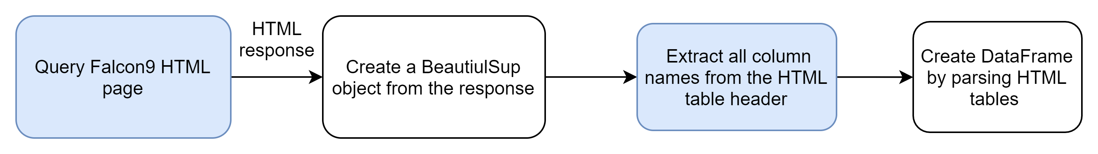
Data Collection - Scraping
Web scraping Falcon 9 and Falcon Heavy Launches Records from Wikipedia
GitHub Url: Data Collection - Web Scraping

Slide 11
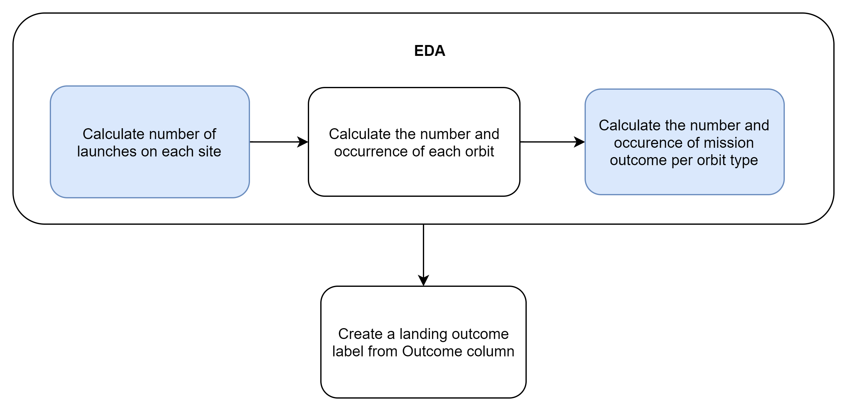
Data Wrangling
Exploratory Data Analysis (EDA) was performed on the dataset
This involved calculating launches per site, occurrences of each orbit and occurrences of mission outcome per orbit type
Finally, the landing outcome label was created from Outcome column.
GitHub Url: Data Collection - Data Wrangling

Slide 12
EDA with Data Visualization
Exploratory Data Analysis was performed on variables Flight Number, Payload Mass, Launch Site, Orbit, Class and Year.
Plots Used:
Flight Number vs. Payload Mass, Flight Number vs. Launch Site, Payload Mass vs. Launch Site, Orbit vs. Success Rate, Flight Number vs. Orbit, Payload vs Orbit, and Success Yearly Trend
Scatter plots, line charts, and bar plots were used to compare relationships between variables to decide if a relationship exists so that they could be used in training the machine learning model
GitHub Url: EDA - Data Visualization

Slide 13
EDA with SQL
The following SQL queries were performed:
Names of unique launch sites in the space mission
First 5 records where launch sites begin with the string 'CCA’
Total payload mass carried by boosters launched by NASA (CRS)
Average payload mass carried by booster version F9 v1.1
Dates when the first successful landing outcome in ground pad was achieved
Names of the boosters which had success in drone ship and had payload mass greater than 4000 but less than 6000
Total number of successful and failure mission outcomes
Names of booster versions which have carried the maximum payload mass
Failed landing outcomes in drone ship, their booster versions, and launch site names for in year 2015
Count of landing outcomes (such as Failure (drone ship) or Success (ground pad)) between the date 2010-06-04 and 2017-03-20, in descending order
GitHub Url: EDA - SQL

Slide 14
Build an Interactive Map with Folium
Markers, circles, lines and marker clusters were used with Folium Maps
Markers were used indicate points like launch sites
Circles were used to indicate highlighted areas around specific coordinates, like NASA Johnson Space Center
Lines were used to indicate distances between two coordinates.
Marker clusters were used to indicate groups of events in each coordinate, like launches in a launch site
GitHub Url: Interactive Map - Folium

Slide 15
Build a Dashboard with Plotly Dash
The following graphs and plots were used to create a dashboard using Plotly Dash
Pie chart to visualize launch site success rate
Scatter plot to help us determine how success rate varies across launch sites, payload mass, and booster version category.
The dashboard allowed to quickly analyse the relation between payloads and launch sites, helping us to identify the best place to launch based on different payloads.
GitHub Url: Dashboard - Plotly Dash

Slide 16
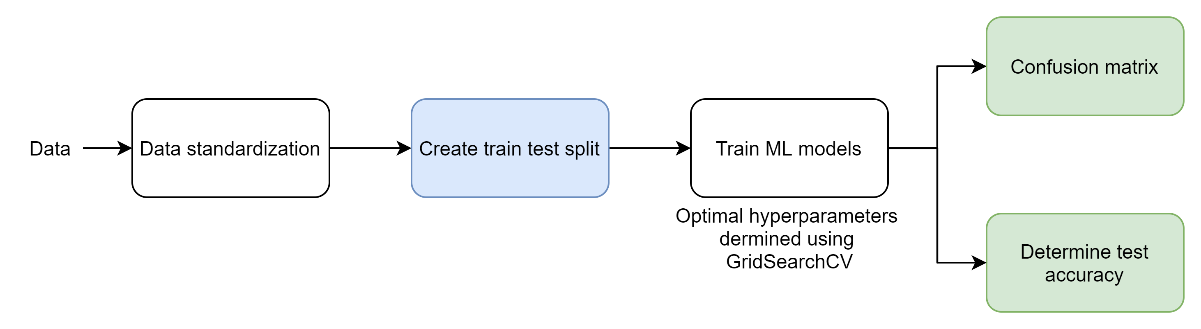
Predictive Analysis (Classification)
Four classification models were developed for predicting whether the first stage of SpaceX Falcon9 rocket would land successfully:
Logistic regression
Support vector machine
Decision tree
K nearest neighbours
GridSearchCV was used to determine the optimal hyperparamerters for each model and the model accuracy was used to determine the optimal ML model
GitHub Url: Machine Learning modeling

Slide 17
Results
Exploratory data analysis results:
Space X uses 4 different launch sites;
The first launches were done to Space X itself and NASA
The average payload of F9 v1.1 booster is 2,928 kg
The first success landing outcome happened in 2015 fiver year after the first launch
Many Falcon 9 booster versions were successful at landing in drone ships having payload above the average
Almost 100% of mission outcomes were successful
Two booster versions failed at landing in drone ships in 2015: F9 v1.1 B1012 and F9 v1.1 B1015
The number of landing outcomes became better as years passed.

Slide 18
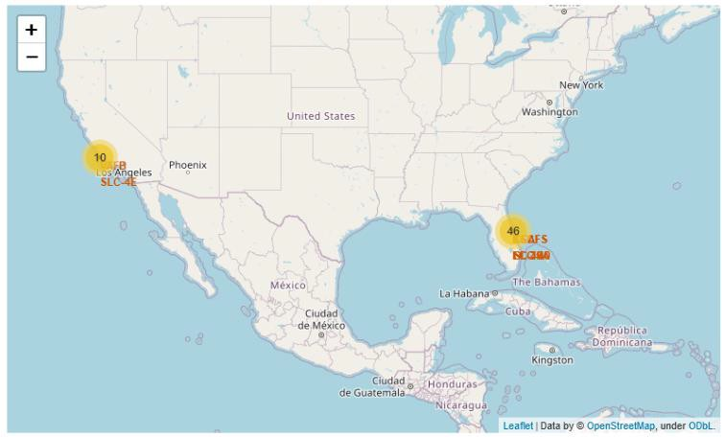
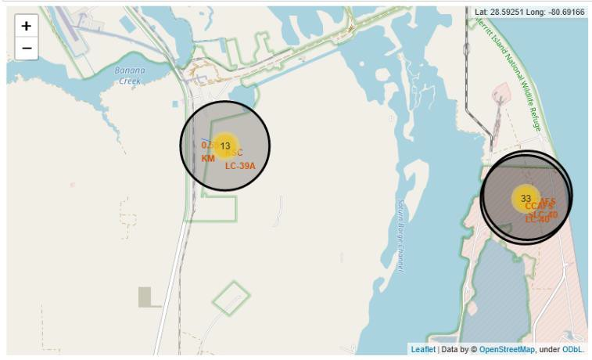
Results
Using interactive analytics was possible to identify that launch sites use to be in
safety places, near sea, for example and have a good logistic infrastructure around.
Most launches happens at east cost launch sites.

Slide 19
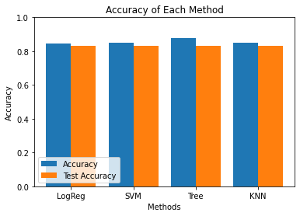
Results
Predictive Analysis showed that all models gave the same test accuracy o 83.33%, whereas on the training set, the Decision Tree Classifier gave the best accuracy of 87.68%

Slide 20

Section 2

Slide 21
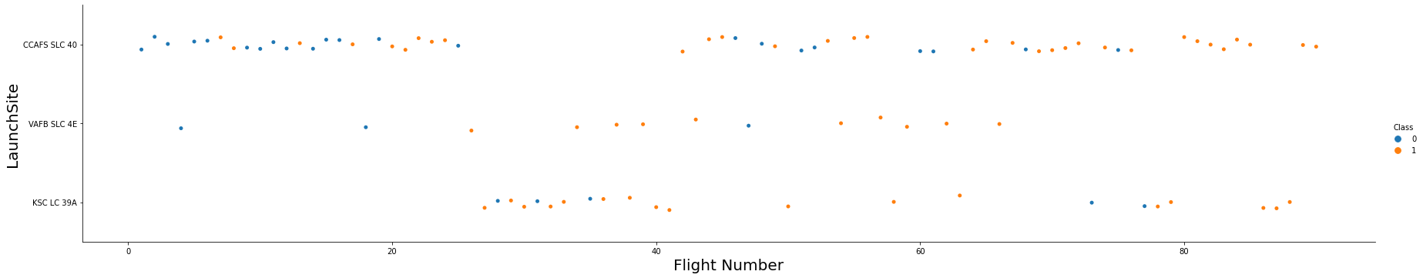
Flight Number vs. Launch Site
According to the plot above, it’s possible to verify that the best launch site nowadays is CCAFS LC-40, where most of recent launches were successful
VAFB SLC 4E is in second place followed by KSC LC-39A in third place
It can also be seen that the general success rate improves over time
21

Slide 22
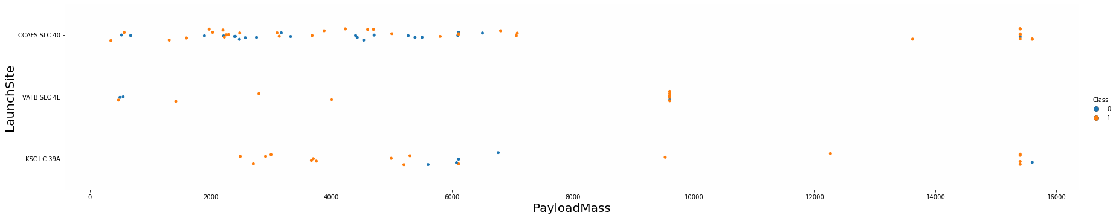
Payload vs. Launch Site
Payloads over 9,000kg (about the weight of a school bus) have excellent success
rate
Payloads over 12,000kg seems to be possible only on CCAFS SLC 40 and KSC LC
39A launch sites.

Slide 23
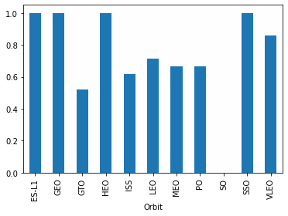
Success Rate vs. Orbit Type
The biggest success rates happens to orbits:
ES-L1
GEO
HEO and
SSO
Followed by:
VLEO (above 80%) and
LFO (above 70%).

Slide 24
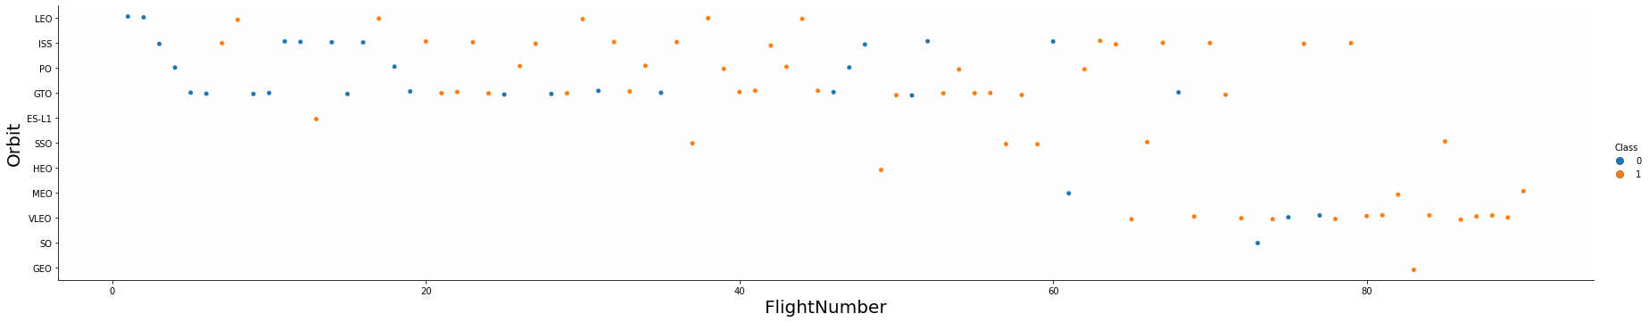
Flight Number vs. Orbit Type
Apparently, success rate improved over time to all orbits
VLEO orbit seems like a new business opportunity, due to recent increase of its frequency

Slide 25
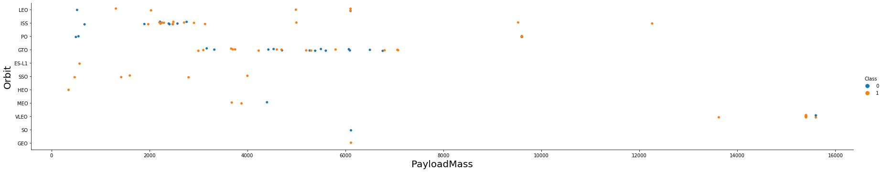
Payload vs. Orbit Type
With heavy payloads the successful landing or positive landing rate are more for Polar, LEO and ISS.
There is no relation between payload and success rate to orbit GTO;
ISS orbit has the widest range of payload and a good rate of success;

Slide 26
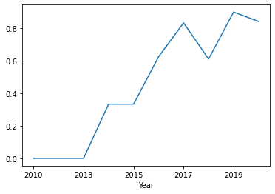
Launch Success Yearly Trend
Success rate has been increasing from 2013 till 2020
It seems that the first three years were a period of adjusts and improvement of technology.

Slide 27
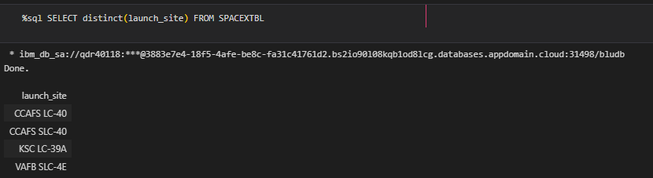
All Launch Site Names
According to data, there are four unique launch sites:

Slide 28
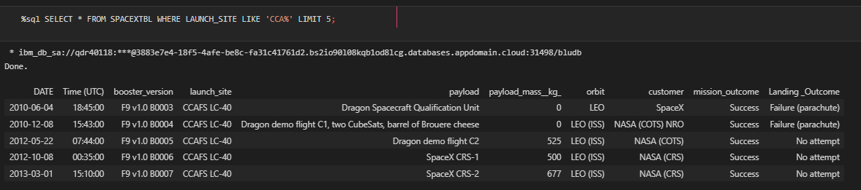
Launch Site Names Begin with 'CCA'
5 records where launch sites begin with `CCA`:
Here we can see five samples of Cape Canaveral launches.

Slide 29
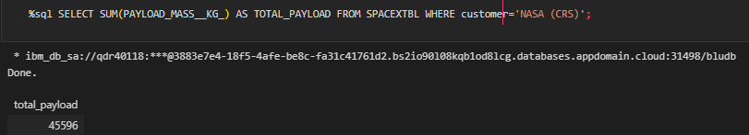
Total Payload Mass
Total payload carried by boosters from NASA (CRS) is 45596 kg:
CRS stands for Commercial Resupply Services which indicates that these payloads were sent to the International Space Station (ISS).

Slide 30
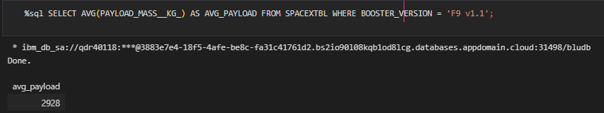
Average Payload Mass by F9 v1.1
Average payload mass carried by booster version F9 v1.1:
Average payload mass of F9 1.1 is on the low end of the payload mass range
30

Slide 31
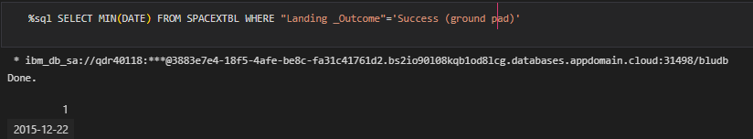
First Successful Ground Landing Date
First successful landing outcome on ground pad:
First ground pad landing wasn’t until the end of 2015
Successful landings in general appear starting 2014
31

Slide 32
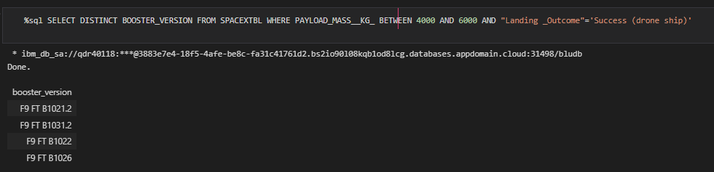
Successful Drone Ship Landing with Payload between 4000 and 6000
Boosters which have successfully landed on drone ship and had payload mass greater than 4000 but less than 6000

Slide 33
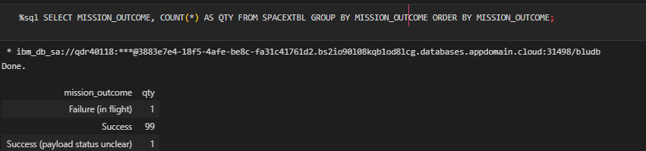
Total Number of Successful and Failure Mission Outcomes
Number of successful and failure mission outcomes:
SpaceX appears to achieve its mission outcome nearly 99% of the time.
This means that most of the landing failures are intended.
Interestingly, one launch has an unclear payload status and one failed in flight.

Slide 34
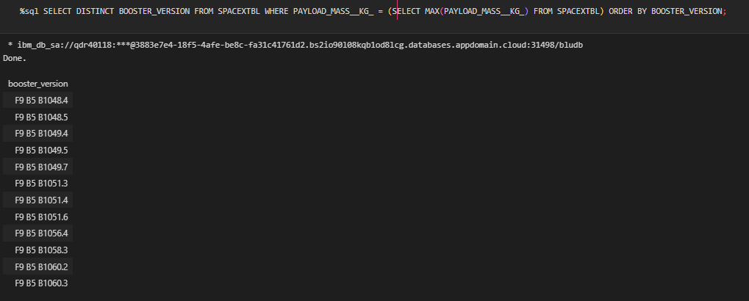
Boosters Carried Maximum Payload
Boosters which have carried the maximum payload mass
These booster versions are very similar and all are of the F9 B5 B10xx.x variety.
This likely indicates payload mass correlates with the booster version that is used.

Slide 35
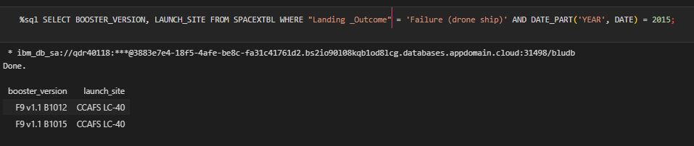
2015 Launch Records
Failed landing outcomes in drone ship, their booster versions, and launch site names for in year 2015
There were only two occurrences.

Slide 36
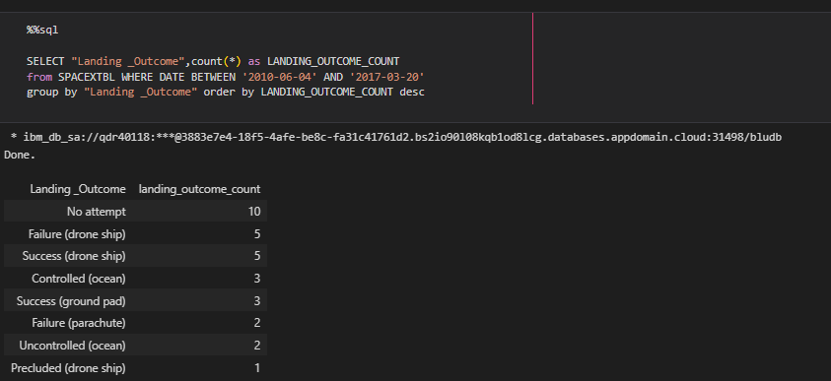
Rank Landing Outcomes Between 2010-06-04 and 2017-03-20
Ranking of all landing outcomes between the date 2010-06-04 and 2017-
03-20:
There are two types of successful landing outcomes: drone ship and ground pad landings.
There were 8 successful landings in total during this time period

Slide 37

Section 3

Slide 38
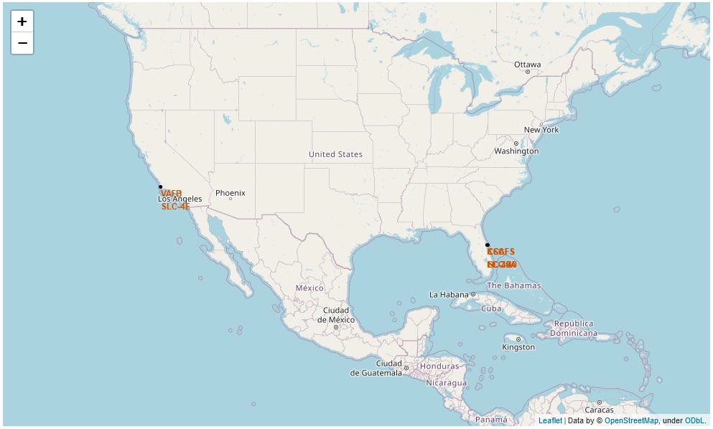
All launch sites
Launch sites are near sea, probably for safety, but are not too far from roads and
railroads.
38

Slide 39

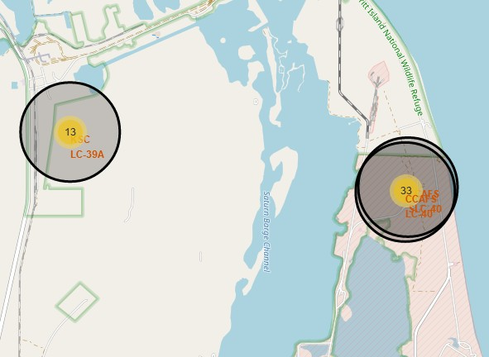
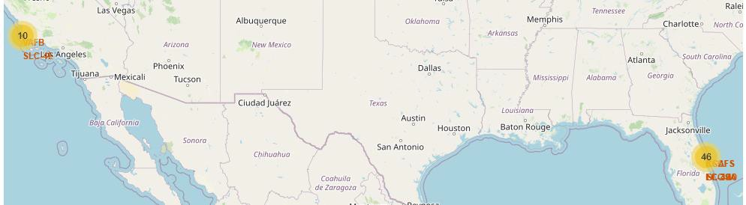

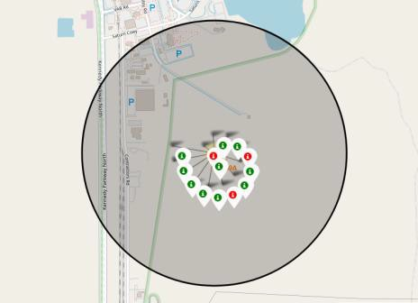
Launch Outcomes by Site
Example of KSC LC-39A launch site launch outcomes
Green markers indicate successful landing and red ones indicate failure.

Slide 40
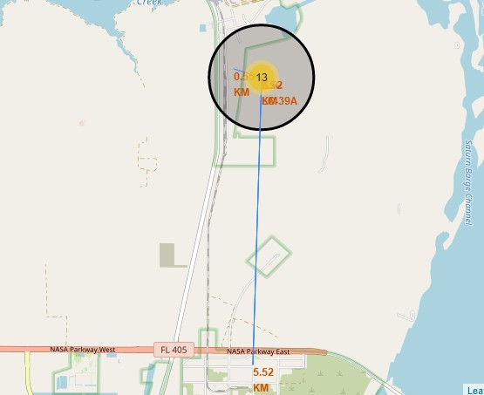
Logistics and Safety
Launch site KSC LC-39A has good logistics aspects, being near railroad and road and relatively far from inhabited areas.

Slide 41

Section 4

Slide 42
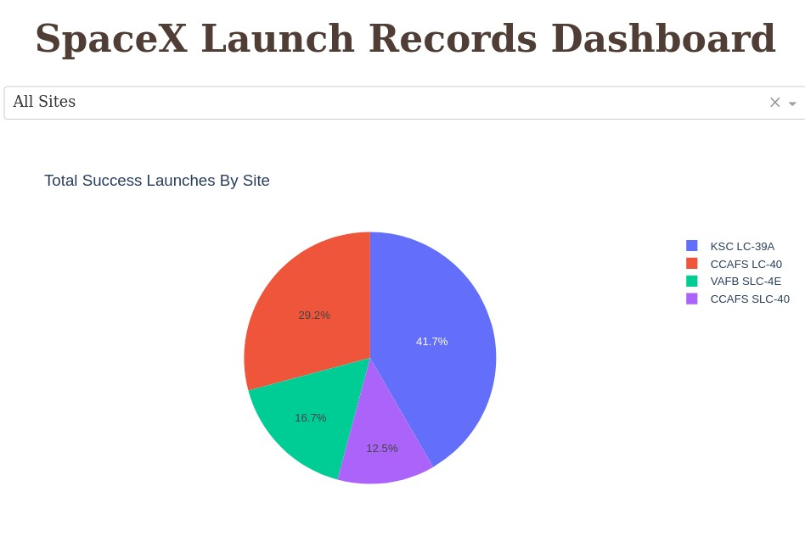
Successful Launches by Site
The place from where launches are done seems to be a very important factor of success of missions.

Slide 43
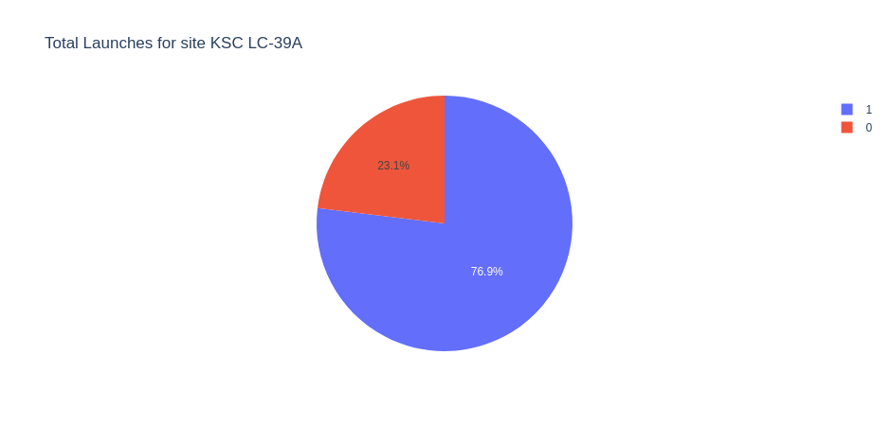
Launch Success Ratio for KSC LC-39A
76.9% of launches are successful in KSC LC-39A

Slide 44
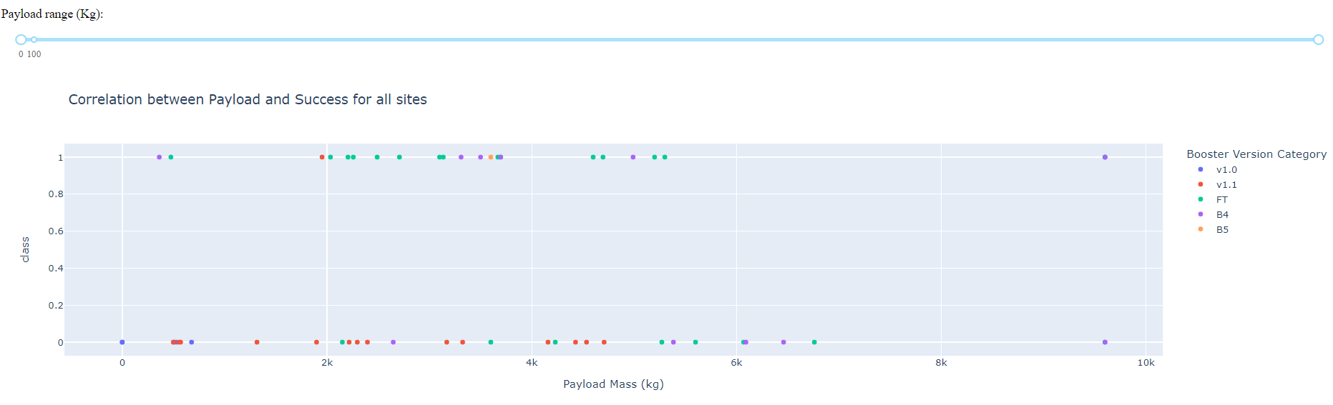
Payload vs. Launch Outcome
Payloads under 6,000kg and FT boosters are the most successful combination.

Slide 45

Section 5

Slide 46
Classification Accuracy
Four classification models were tested, and their accuracies are plotted using bar chart
All models had the same test accuracy o 83.33%, whereas Decision Tree Classifier had the maximum training accuracy of 87.68%
It should be noted that test set has a sample size of only 18 samples.

Slide 47
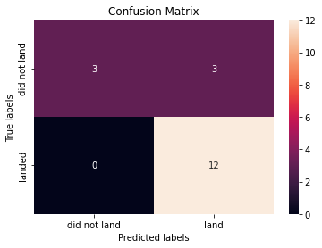
Confusion Matrix of Decision Tree Classifier
Confusion matrix of Decision Tree Classifier:
Out of 12 samples where the first stage landed successfully, the model was able to correctly predict all samples
Out of 6 samples where the first stage failed to land, the model was able to correctly predict half of the samples
Considering successful landing as the positive class, the model has a recall of 100% and a precision of 80%

Slide 48
Conclusions
Different data sources were analyzed, refining conclusions along the
process
Used data from a public SpaceX API and web scraping SpaceX Wikipedia page
Created data labels and stored data into a DB2 SQL database
Created a dashboard for visualization
Explored multiple ML models and achieved an accuracy of 83%
Allon Mask of SpaceY can use this model to predict with relatively high accuracy whether a launch will have a successful Stage 1 landing before launch to determine whether the launch should be made or not
If possible more data should be collected to better determine the best machine learning model and improve accuracy

Slide 49
Appendix
GitHub repository url:
https://github.com/VISHWANATHAN007/IBM-Applied-Data-Science-Capstone
Instructors:
Rav Ahuja, Alex Aklson, Aije Egwaikhide, Svetlana Levitan, Romeo Kienzler, Polong Lin, Joseph Santarcangelo, Azim Hirjani, Hima Vasudevan, Saishruthi Swaminathan, Saeed Aghabozorgi, Yan Luo
Special Thanks to All Instructors:
https://www.coursera.org/professional-certificates/ibm-data-science?#instructors

Slide 50


